Slide 1
Meme Stocks
Hype or Opportunity?

Slide 2


A failing business model…

Slide 3

Bankruptcy and more…

Slide 4
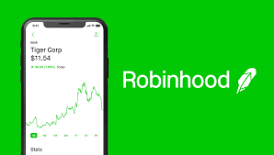
Rise of the Retail Investor….

Slide 5

Influence of online stock forums

Slide 6
4 Questions
For our analysis

Slide 7
1) Can Meme Stocks stand up to a traditional financial analysis?
Vs S&P 500, Sharpe Ratio, Monte Carlo Simulations

Slide 8
2) Are Meme Stock investors the same as Cryptocurrency investors?
Can this be proven by a negative correlation?

Slide 9
3) Are Meme Stocks Driven by online forums such as Wallstreetbets?
Is there a way to prove this statistically?

Slide 10
4) Are Meme Stocks a real money-making opportunity?

Slide 11
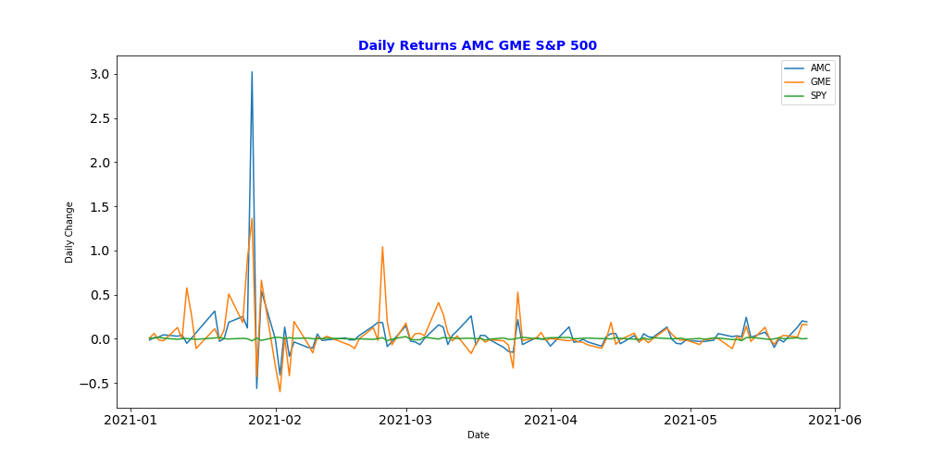
Compare to S&P 500

Slide 12
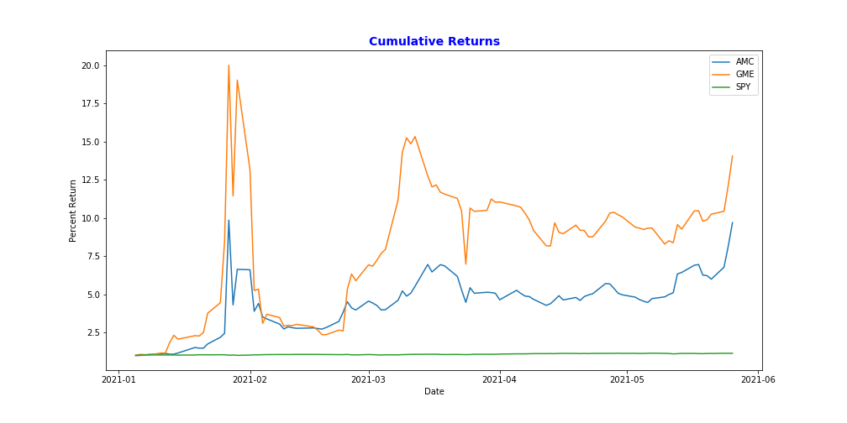
Cumulative Returns vs S&P 500

Slide 13
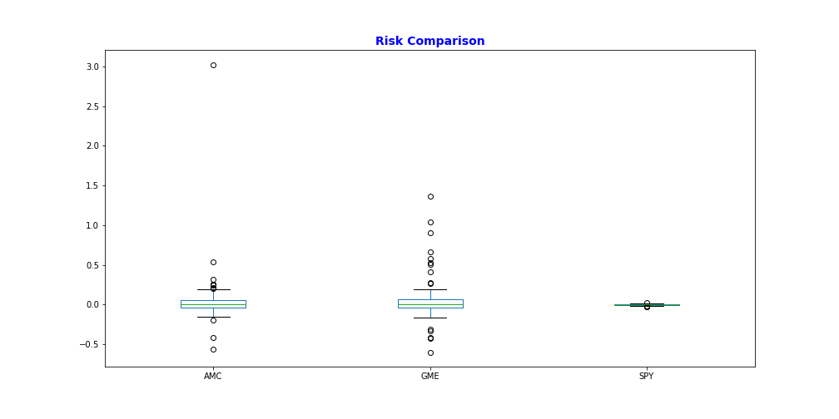
Risk compared to S&P 500

Slide 14
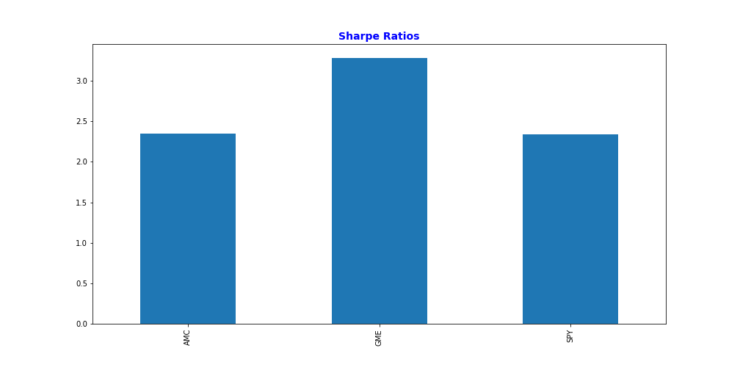
Sharpe Ratios vs S&P 500

Slide 15
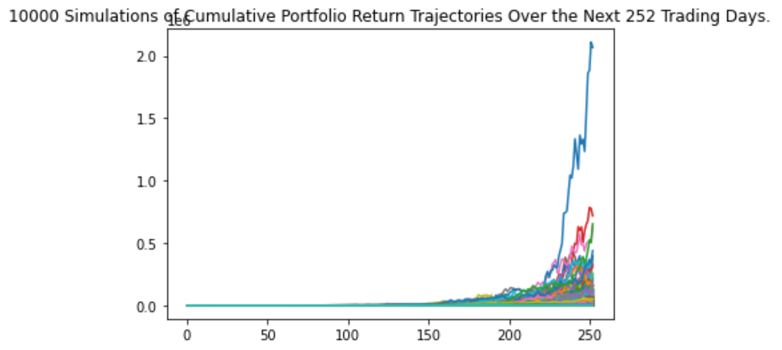
Monte Carlo Simulations

Slide 16
Impressive Monte Carlo results
95% chance $1,000 initial investment over 1 year will end in a range of $6,281.01 to $30,569,750.65.
Portfolio 1/3 GME, 1/3 AMC, 1/3 SPY

Slide 17
Note: this is based on only five months history of the Meme Stocks
Most traditional Monte Carlo Simulations draw on years of previous stock history, but we were examining the meme stock phenomena which started in January 2021

Slide 18
Crypto Meme Correlation
Is there statistical Evidence people are investing back and forth between cryptocurrencies and Meme stocks?

Slide 19
We compared Bitcoin and Dogecoin to the Meme Stocks
Using Daily Cumulative Return results

Slide 20
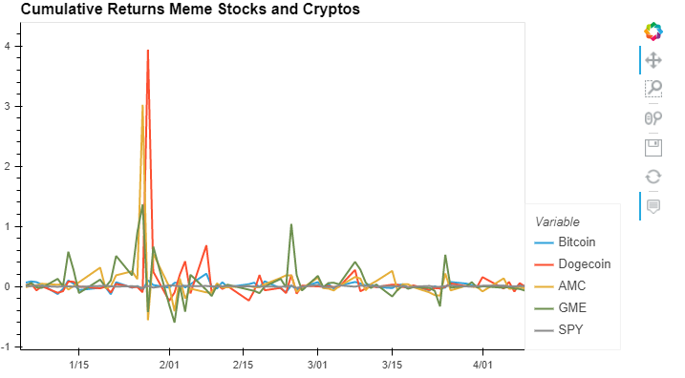
Daily Crypto Cumulative Returns vs
Daily Meme Stocks Cumulative Returns

Slide 21
No Negative Correlation
There is no statistical evidence money is changing from cryptocurrencies to meme stocks

Slide 22
Data to show Meme Stocks driven by online forums
We decided to scrape mentions of the meme stocks on the wallstreetbets subreddit

Slide 23
We used the PRAW tool
Python Reddit API Wrapper

Slide 24
It scraped the top titles from the wallstreetbets subreddit
We then calculated the number of mentions of GameStop and amc per day

Slide 25
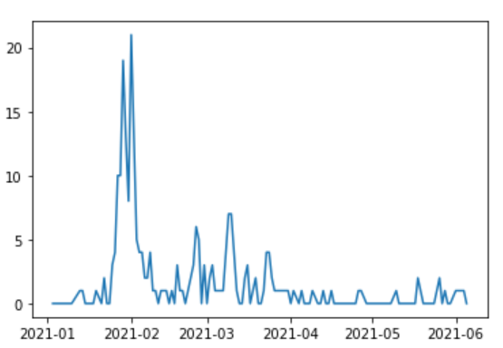
Mentions on wallstreets bets

Slide 26
Meme Stock Daily Results vs wallstreetbets Mentions
There was a strong correlation between mentions and meme stock performance

Slide 27
Conclusion #1
The Meme Stocks stood up well to traditional financial analysis especially with the monte Carlo simulations

Slide 28
Conclusion #2
The theory that the same investors are moving money back And forth between cryptocurrencies and meme stocks appears to be statistically false

Slide 29
Conclusion #3
There is a strong correlation between online forum mentions and meme stock performance

Slide 30
Conclusion #4
Financial analysis shows that there is money making opportunity with meme stocks
Monitoring number of mentions on online forums (rather than content) may be a good strategy

